Slide 1
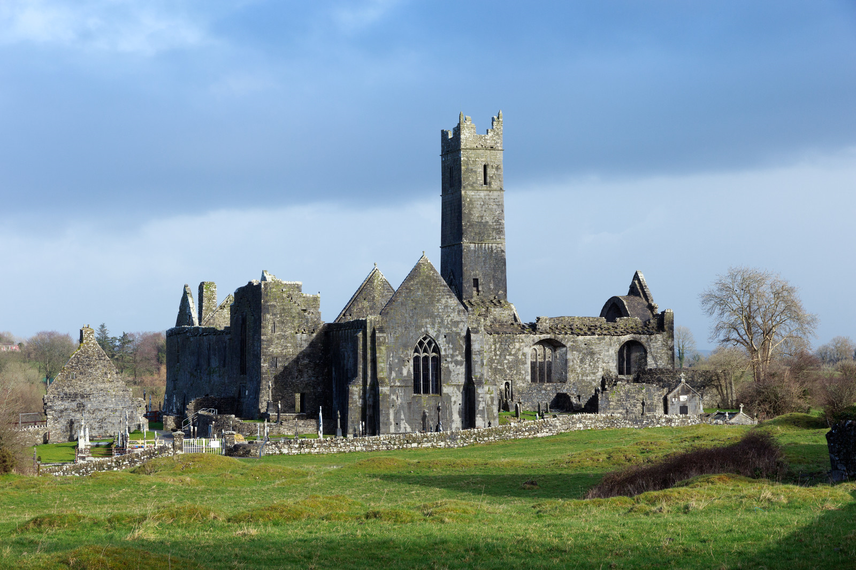
Graveyards and Burial Records as Genealogical Sources.

Slide 2
Mount St. Lawrence Cemetery Limerick.
This cemetery opened in 1849.
Since its opening, it has acted as the primary place for burial for the diverse population of Limerick
Mount Saint Lawrence Cemetery has a searchable database that makes it easy to locate graves and their records.

Slide 4
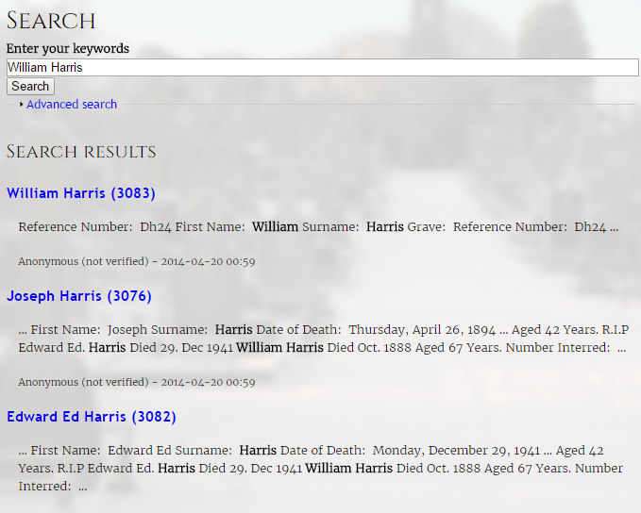

Slide 6
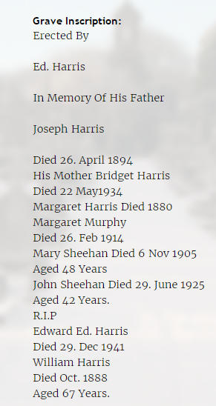
Notes:
This correlates with my findings on the census that my Great Great Grandfather had a brother named Edward, Father named Joseph and Mother named Bridget. Moreover, I know the family married into Murphys through his sister Margaret, also through the Census.

Slide 7
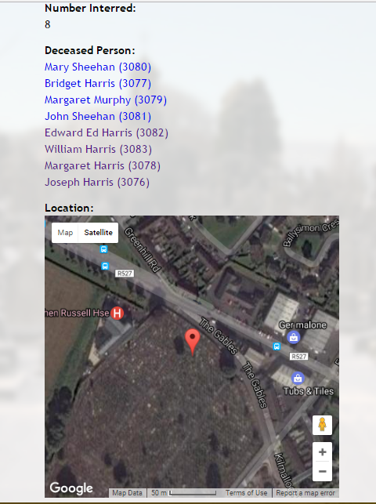

Slide 8
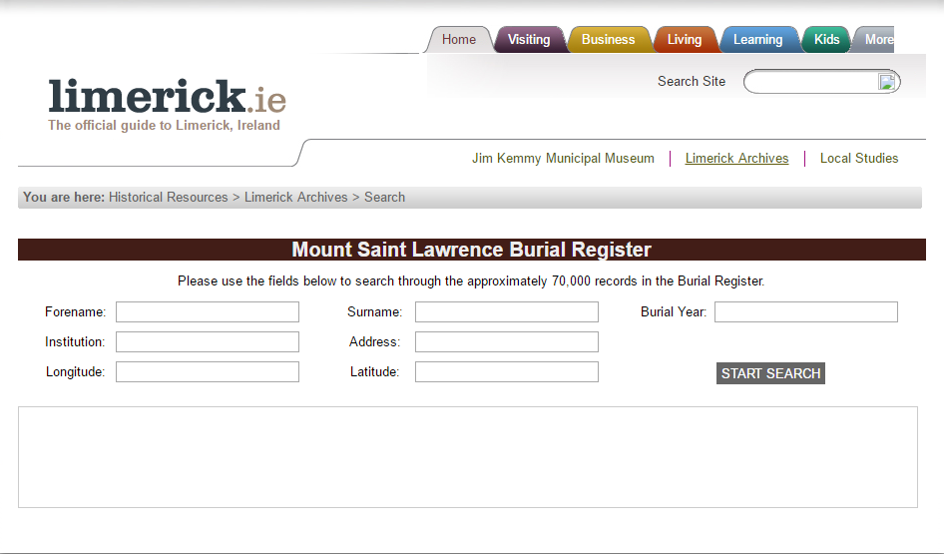

Slide 9
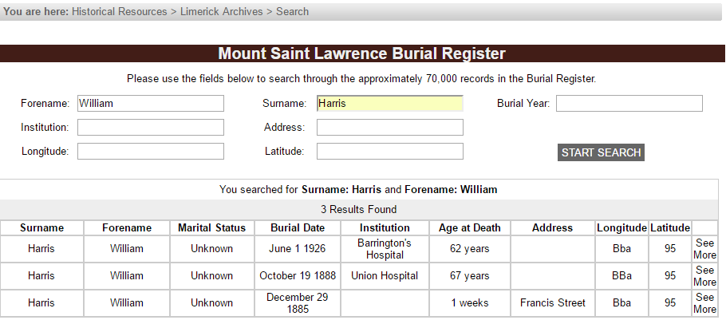
Notes:
I know this is my William Harris as he died in 1888 which suits my other findings.

Slide 10
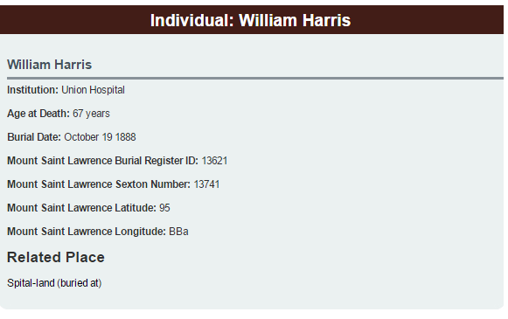
Notes:
SEE MORE

Slide 11
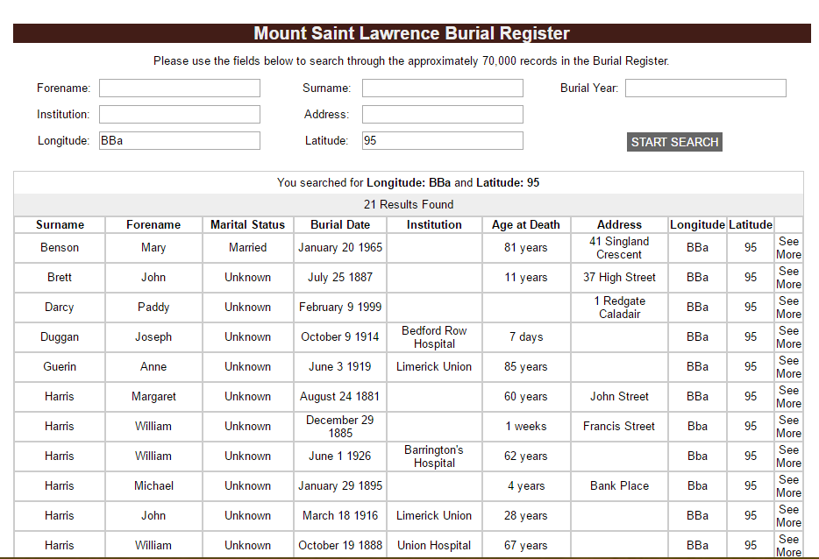
Notes:
Search with Latitude and Longitude → More members not mentioned on grave, eg John and Michael Harris

Slide 12
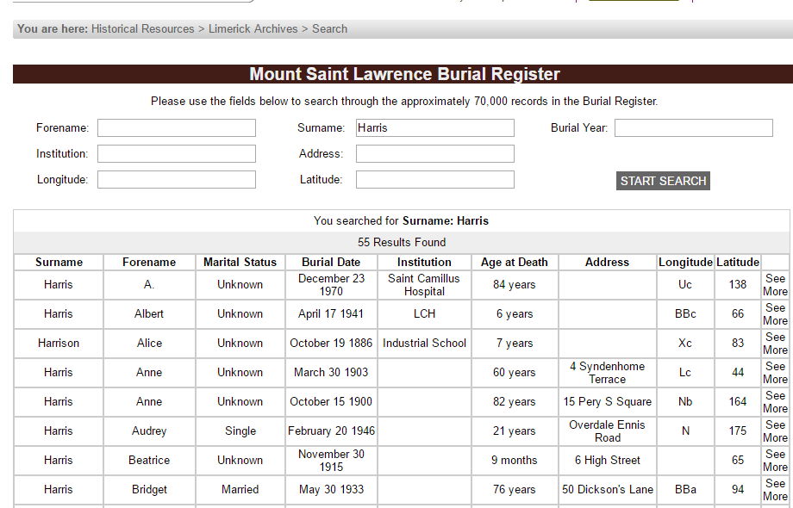
Notes:
Can also search for surname in general and see what comes up and if any suit your other findings.

Slide 13
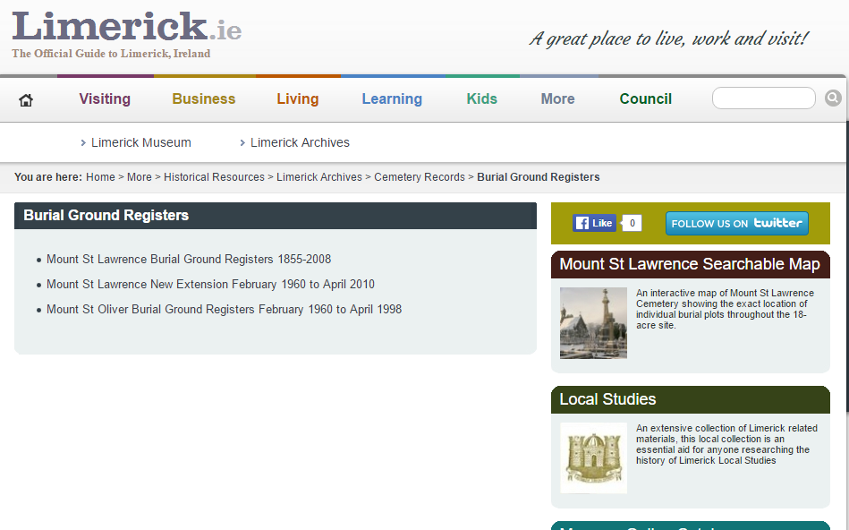
Registers of the Mount St. Lawrence Extension (1960-2010) and Mount St. Oliver (1978-1998) are also accessible through Limerick.ie.

Slide 14
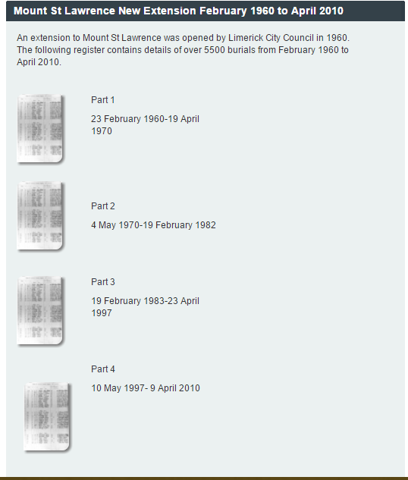
Notes:
Need djvu to see, get pics on computers in college.

Slide 15
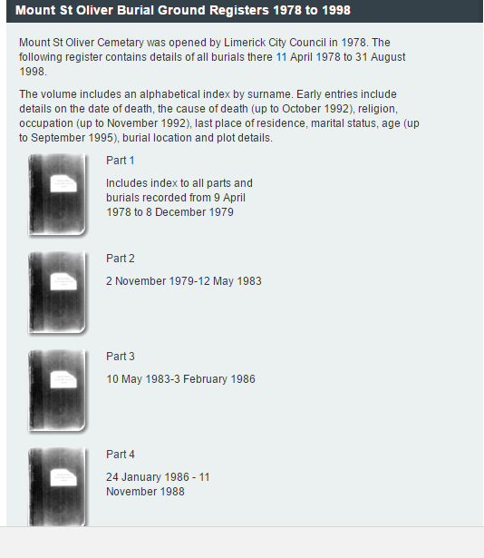
Notes:
Need dkvu to see

Slide 16
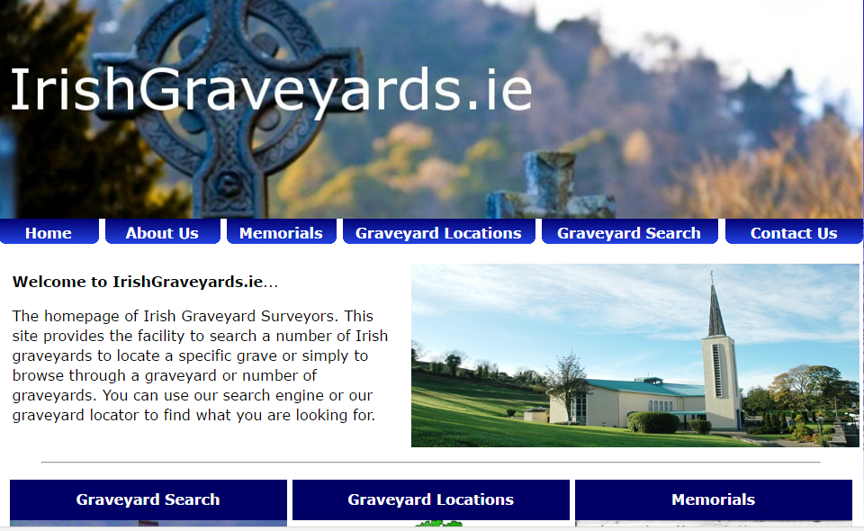

Slide 17
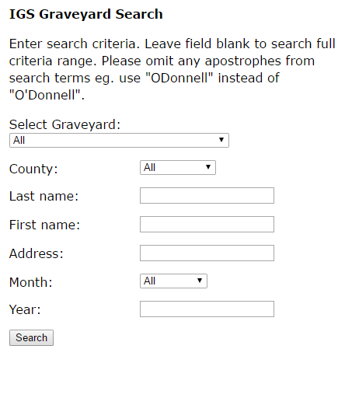
Notes:
Add page with example

Slide 18
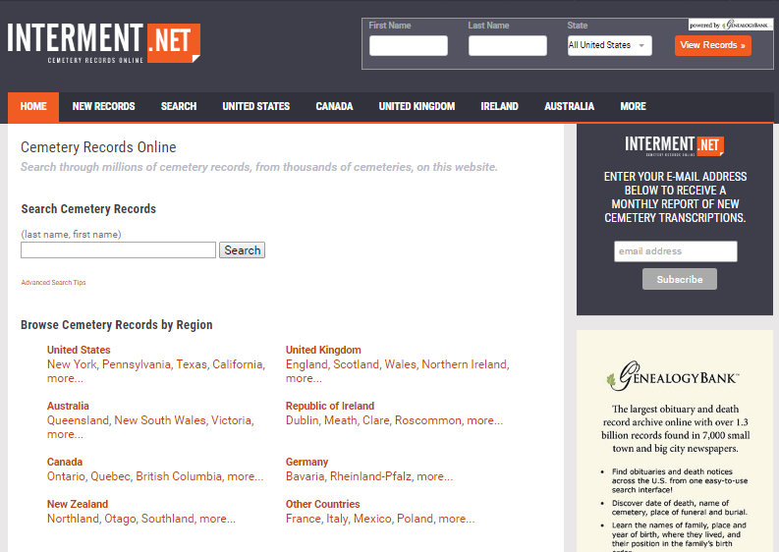

Slide 19
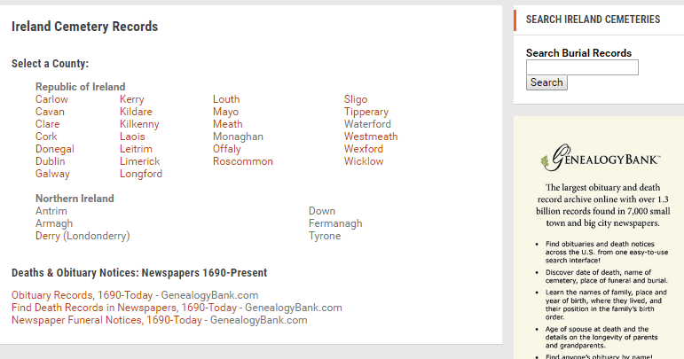

Slide 20
